Slide 1
Switching, routing, and flow control in interconnection networks

Slide 2
Switching mechanism
How a packet/message passes a switch
Traditional switching mechanisms
  Packet switching
    Messages are chopped into packets, each packet is switched independently.
      E.g. Ethernet packet: 64-1500 bytes.
    The switching happens after the whole packet is in the input buffer of a switch.
      Store-and-forward
  Circuit switching
    The circuit is set up first (the connection between the input and output ports alone the whole path are set up).
    No routing delay
    Too much start-up overheads, no suitable for high performance communication.
  Packet switching for computer communications and circuit switching for telephone communications.

Slide 3
Switching mechanism
Traditional packet switching
  Store-and-Forward
    A switch waits for the full packet to arrive before sending it to the next switch
    Application: LAN (Ethernet), WAN (Internet routers)
  Drawback: packet latency is proportional to the number of hops (links).
    Latency is not scalable with packet switching

Slide 4
Switching mechanism
Switching for high performance communication: cut-through (switching/routing)
  Packet is further cut into flits.
    Flit size is very small, e.g. 4 bytes, 8 bytes, etc.
    A packet will have one header flit, and many data flits.
  A switch examines the header (header flit) and forward the message before the whole packet arrives.
  Pipeline in the unit of flits.
  Application: most high-end switches (InfiniBand, Myrinet, also used in all MPP machines).

Slide 5
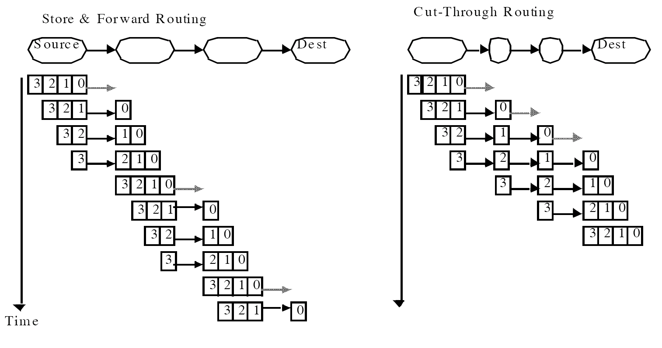
Store-and-forward vs. cut-through
Time = h (n/b + D) Time = n/b + D h
D is the overhead for preparing to send one flit. The latency is almost independent of h with cut-through switching
  Crucial for latency scalability.

Slide 6
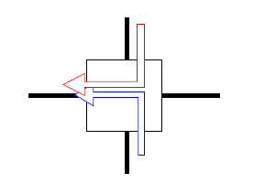
Cut-through routing variation
Cut through routing: when the header of a message is blocked, the whole message will continue until it is buffered in the blocked router.
  Need to be able to buffer multiple packets
  High buffer requirement in routers
  Eventually, when all buffers are full, the sender will stop sending.
Wormhole routing
  Cut through routing with buffer for only one flit for each channel
  Minimum buffer requirement
  Each channel has the flow control mechanism.
  when the header is blocked, the message stop moving (the message is buffed in a distributed manner, occupying buffers in multiple routers).

Slide 7
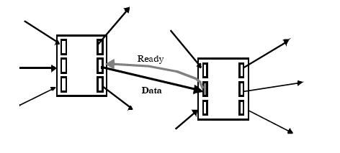
Contention and link level flow control
Two messages try to use the same outgoing link
  One needs to either buffered or droped.
Wormhole networks try to block in place: link-level flow control.
  A message may occupy multiple links.
  Cut through routing has the same effect when more data are in the network.
This kind of networks are also call lossless networks.
  No packet is ever dropped by the network.
  Is the Internet lossless? Which one is better, lossy or lossless network?

Slide 8
Lossless network and tree saturation
Lossless networks have very different congestion behavior from lossy networks such as the Internet
  In a lossy networks, congestion is limited to a small region.
  In a lossless network with cut-through or wormhole routing, congestion will spread to the whole network.
    Messages that do not use the congested link may also be blocked.
    This is known as tree saturation.
    The congested link is the root of the tree.

Slide 9
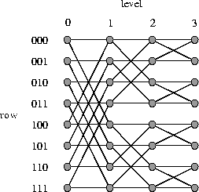
Tree saturation
001->000
111->000
blocked

Slide 10
Tree saturation
001->000
111->000
011->001
110->001
Not directly go
through the
congested link,
but blocked.

Slide 11
Tree saturation
Tree saturation
can happen in any topology

Slide 12
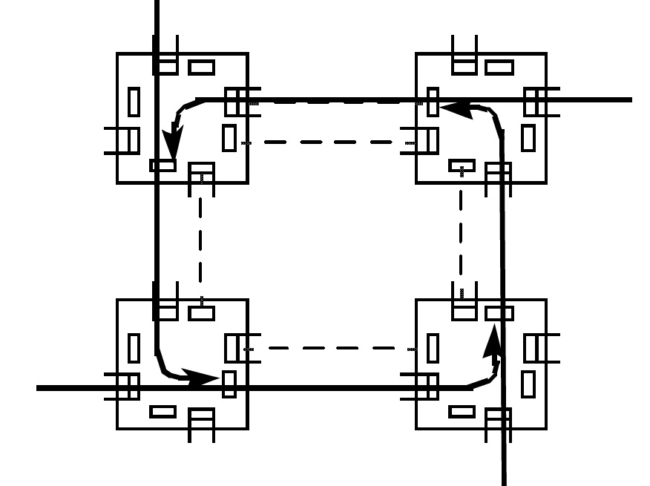
Lossless network and deadlock
  Wormhole routing: hold on to the buffer when blocked.
    Hold and wait → this is the formula for deadlock.
    Solution?

Slide 13
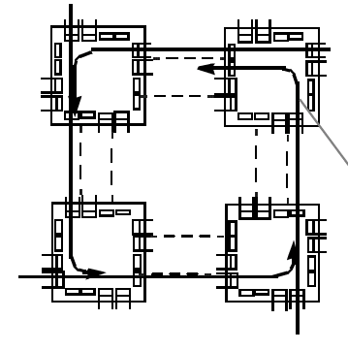
Virtual channels
A logical channel can be realized with one buffer and the related flow control mechanism.
  At one time, one message use the link.
We can allow multiple messages to share the link by having multiple virtual channels:
  Each virtual channel has one buffer with the related flow control mechanism.
  The switch can use some scheduling algorithm to select flits in different buffer for forwarding.
  With virtual channel, the train slows down, but not stops when there is network contention.
Virtual channels increase resource sharing and alleviate to the deadlock problem.

Slide 14
Routing
Routing algorithms: determine the path from the source to the desintation
Properties of routing algorithm:
  Deterministic: routes are determined by source and destination pair, but other states (e.g. traffic)
  Adaptive: routes are influenced by traffic along the way.
  Minimal: only selects shortest path.
  Deadlock free: no traffic pattern can lead to a deadlock situation.

Slide 15

Routing mechanism
Source routing: message include a list of intermediate nodes (or ports) toward the destination. Intermediate routers just lookup and forward.
Destination based routing: message only includes the destination address. Intermediate routers use the address to compute the output port (e.g. dest addr as an index to the forwarding table).
  Deterministic: always follow the same path
  Adaptive: pick different paths to avoid congestion
  Randomized: pick between several good paths.

Slide 16
Routing algorithms
Regular topology
  Dimension order routing with k-ary n-cube
    Ring, mesh, torus, hypercube
    Resolve the address differences in each dimension one after another
  Tree routing (no routing issue)
  Fat-tree?
Irregular topology
  Shortest path (like the Internet)

Slide 17
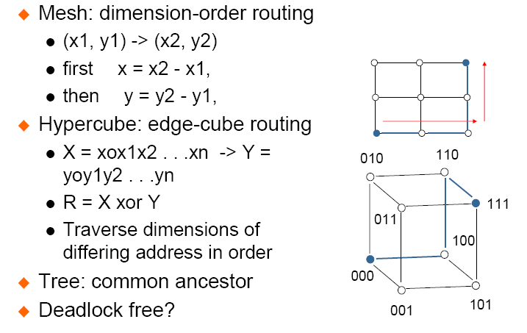
Routing on regular topology examples

Slide 18
Irregular topology
Mostly shortest path based.
  How to make sure there is no deadlock?

Slide 19
Deadlock free routing
Make sure that the loop can never occur
  Put constraints on how paths can be used to route traffic.
  Use infinite virtual channels.
Deadlock free routing example:
  Up/down routing
    Select a root node and build a spanning tree
    Links are classified as up links or down links
      Up links: from lower level to upper level
      Down links: from upper level to lower level
      Link between nodes in the same level: up/down based on node number
    Path: all up link, all down link, a sequence of up links followed by a sequence of down links
      No up link can follow a down link.
  Why deadlock free?
  Can we have disconnected nodes?

Slide 20
Deadlock free routing
Is X-Y routing on mesh deadlock free?
How about adaptive routing on mesh that always use the shortest paths?

Slide 21
Network interface design issue
The network requirement for a typical high performance computing user
  In-order message delivery
  Reliable delivery
    Error control
    Flow control
  Deadlock free
Typical network hardware features
  Arbitrary delivery order (adaptive/multipath routing)
  Finite buffering
  Limited fault handling
Where should the user level functions be realized?
  Network hardware? Network systems? Or a hardware/systems/software approach?

Slide 22
Where should these functions be realized?
  How does the Internet realize these functions?
    No deadlock issue
    Reliability/flow control/in-order delivery are done at the TCP layer?
    The network layer (IP) provides best effort service.
      IP is done in the software as well.
  Drawbacks:
    Too many layers of software
    Users need to go through the OS to access the communication hardware (system calls can cause context switching).

Slide 23
Where should these functions be realized?
  High performance networking
    Most functionality below the network layer are done by the hardware (or almost hardware)
      This provide the APIs for network transactions
    If there is mis-match between what the network provides and what users want, a software messaging layer is created to bridge the gaps.

Slide 24
Messaging Layer
Bridge between the hardware functionality and the user communication requirement
  Typical network hardware features
    Arbitrary delivery order (adaptive/multipath routing)
    Finite buffering
    Limited fault handling
  Typical user communication requirement
    In-order delivery
    End-to-end flow control
    Reliable transmission

Slide 25
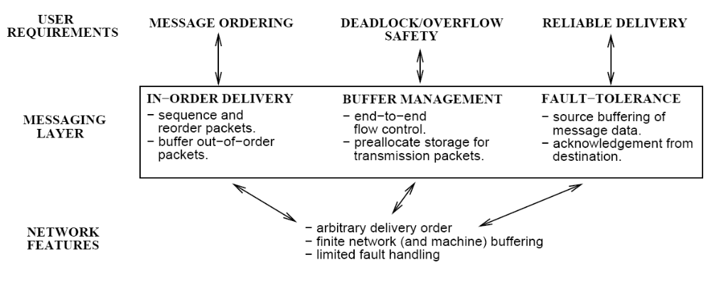
Messaging Layer

Slide 26
Communication cost
Communication cost = hardware cost + software cost
  Hardware message time: msize/bandwidth
  Software time:
    Buffer management
    End-to-end flow control
    Running protocols
  Which one is dominating?
    Depends on how much the software has to do.

Slide 27
Network software/hardware interaction -- a case study
A case study on the communication performance issues on CM5
  V. Karamcheti and A. A. Chien, “Software Overhead in Messaging layers: Where does the time go?” ACM ASPLOS-VI, 1994.

Slide 28
What do we see in the study?
The mis-match between the user requirement and network functionality can introduce significant software overheads (50%-70%).
Implication?
  Should we focus on hardware or software or software/hardware co-design?
  Improving routing performance may increase software cost
    Adaptive routing introduces out of order packets
  Providing low level network feature to applications is problematic.

Slide 29
Summary
In the design of the communication system, holistic understanding must be achieved:
  Focusing on network hardware may not be sufficient. Software overhead is much larger than routing time.
It would be ideal for the network to directly provide high level services.

